Slide 1

Multicurrency Online Banking System V1.0
ABC Bank
Lu Jia

Slide 2
Agenda:
Project Overview
Database Design
System Specs and Features
Future Enhancements

Slide 3
Project Overview:
Goal
To create a multicurrency online banking system for end users that includes all basic functions of a modern-day online wallet: view account balance, view transaction history, convert between currencies, perform fund transfer, etc.
Timeline
To deliver a working prototype (v1) within one sprint of 3 weeks
Scope
Modules include: Registration and Login, Account Overview, Transaction History, Create New Account, Add Currency to Existing Account, Transfer to Own Account, Transfer to Other Accounts

Slide 4
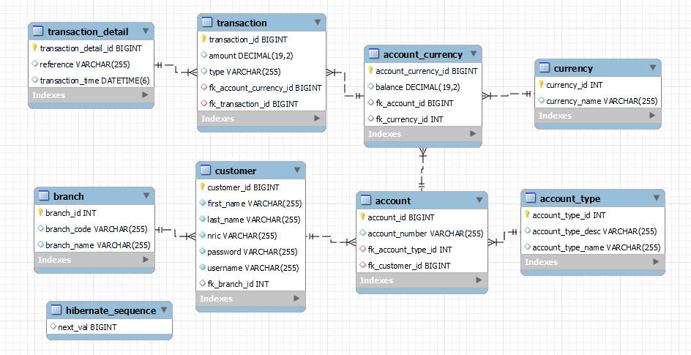
Database Design:

Slide 5
System Specs and Features:
Spring Boot 2.7.3 with JPA and MySQL
Basic password encryption
Frontend and backend form validation
Integration with a REST API (APILayer) to obtain real-time exchange rate for currency conversion
Includes a setup class which applies configurations when the application starts

Slide 6
Future Enhancements:
Use Spring Security for authentication and access control
Use Spring WebClient to communicate with the FX REST API (currently using Jackson to deserialize)
Add sorting, searching and pagination to transaction history

